Slide 1

Introduction to Qt: How to Create Your First Interface
Session 02

Slide 2
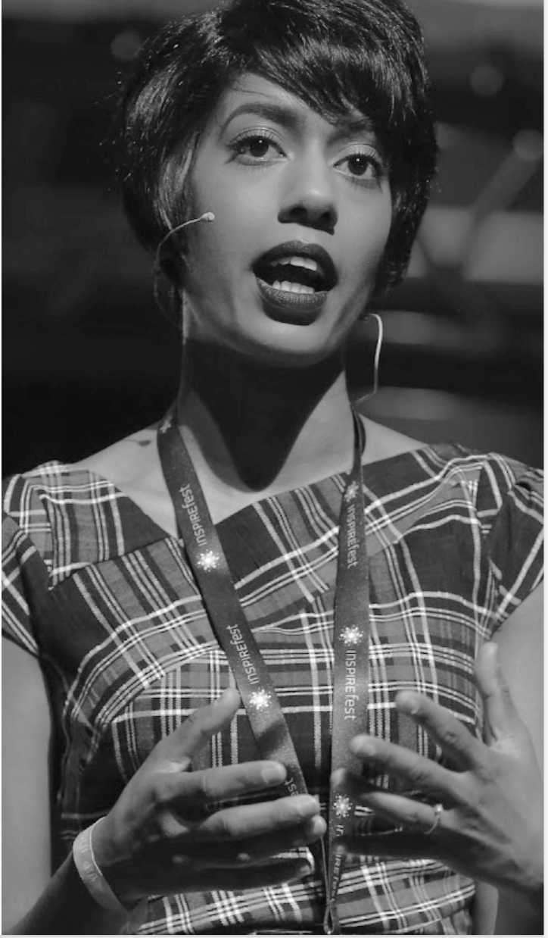


Our Mission
Inspiring women to
excel in technology
careers.

Slide 3
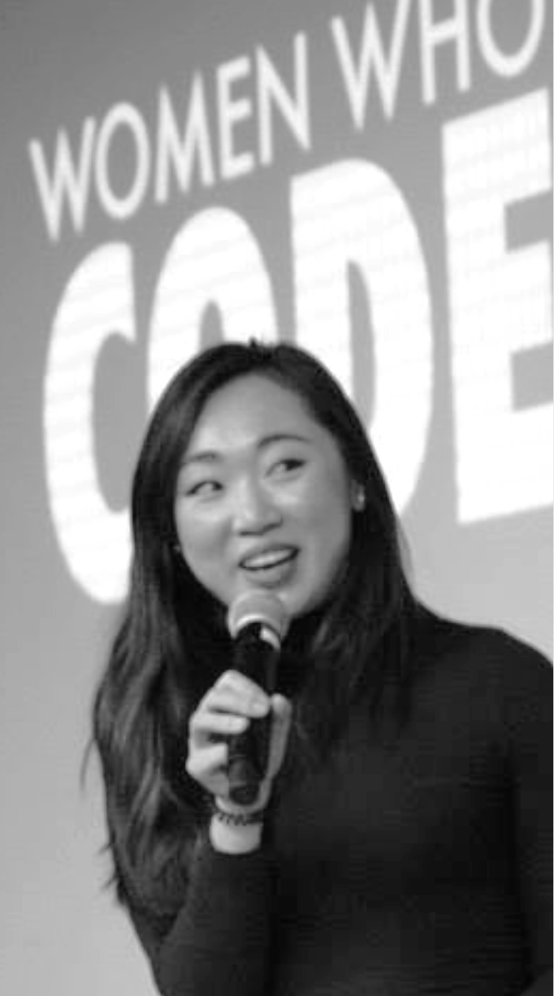
Our Vision
A world where diverse women are better represented as engineers and tech leaders

Slide 4
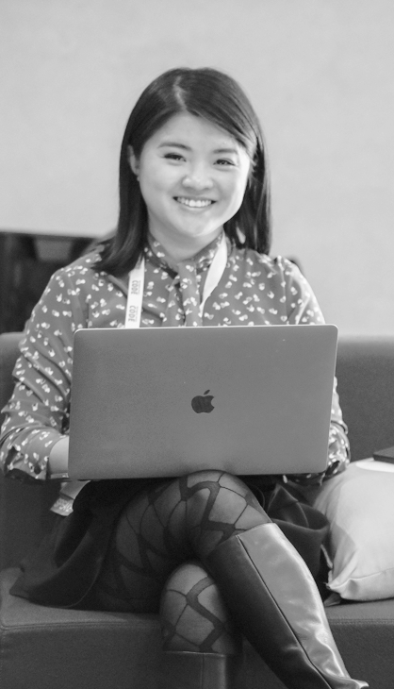
Our Target
Engineers with two or more years of experience looking for support and resources to strengthen their influence and levelup in their careers.

Slide 5
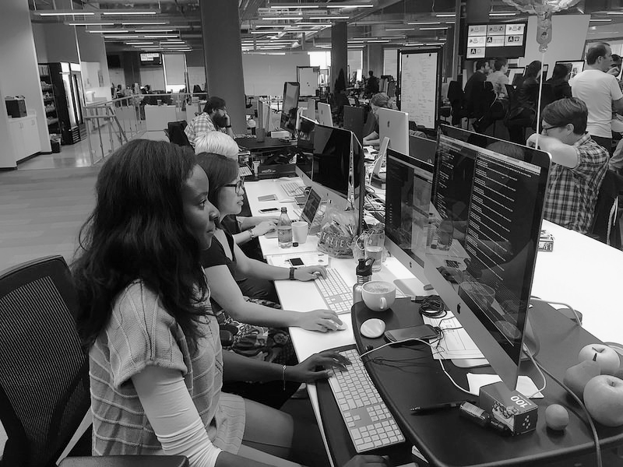
290,000
Members
70 networks in 20 countries
122+ countries
14K+ events
$1025 daily Conference tickets
$2M Scholarships
Access to jobs + resources
Infinite connections
Notes:
290,000 and growing!

Slide 6
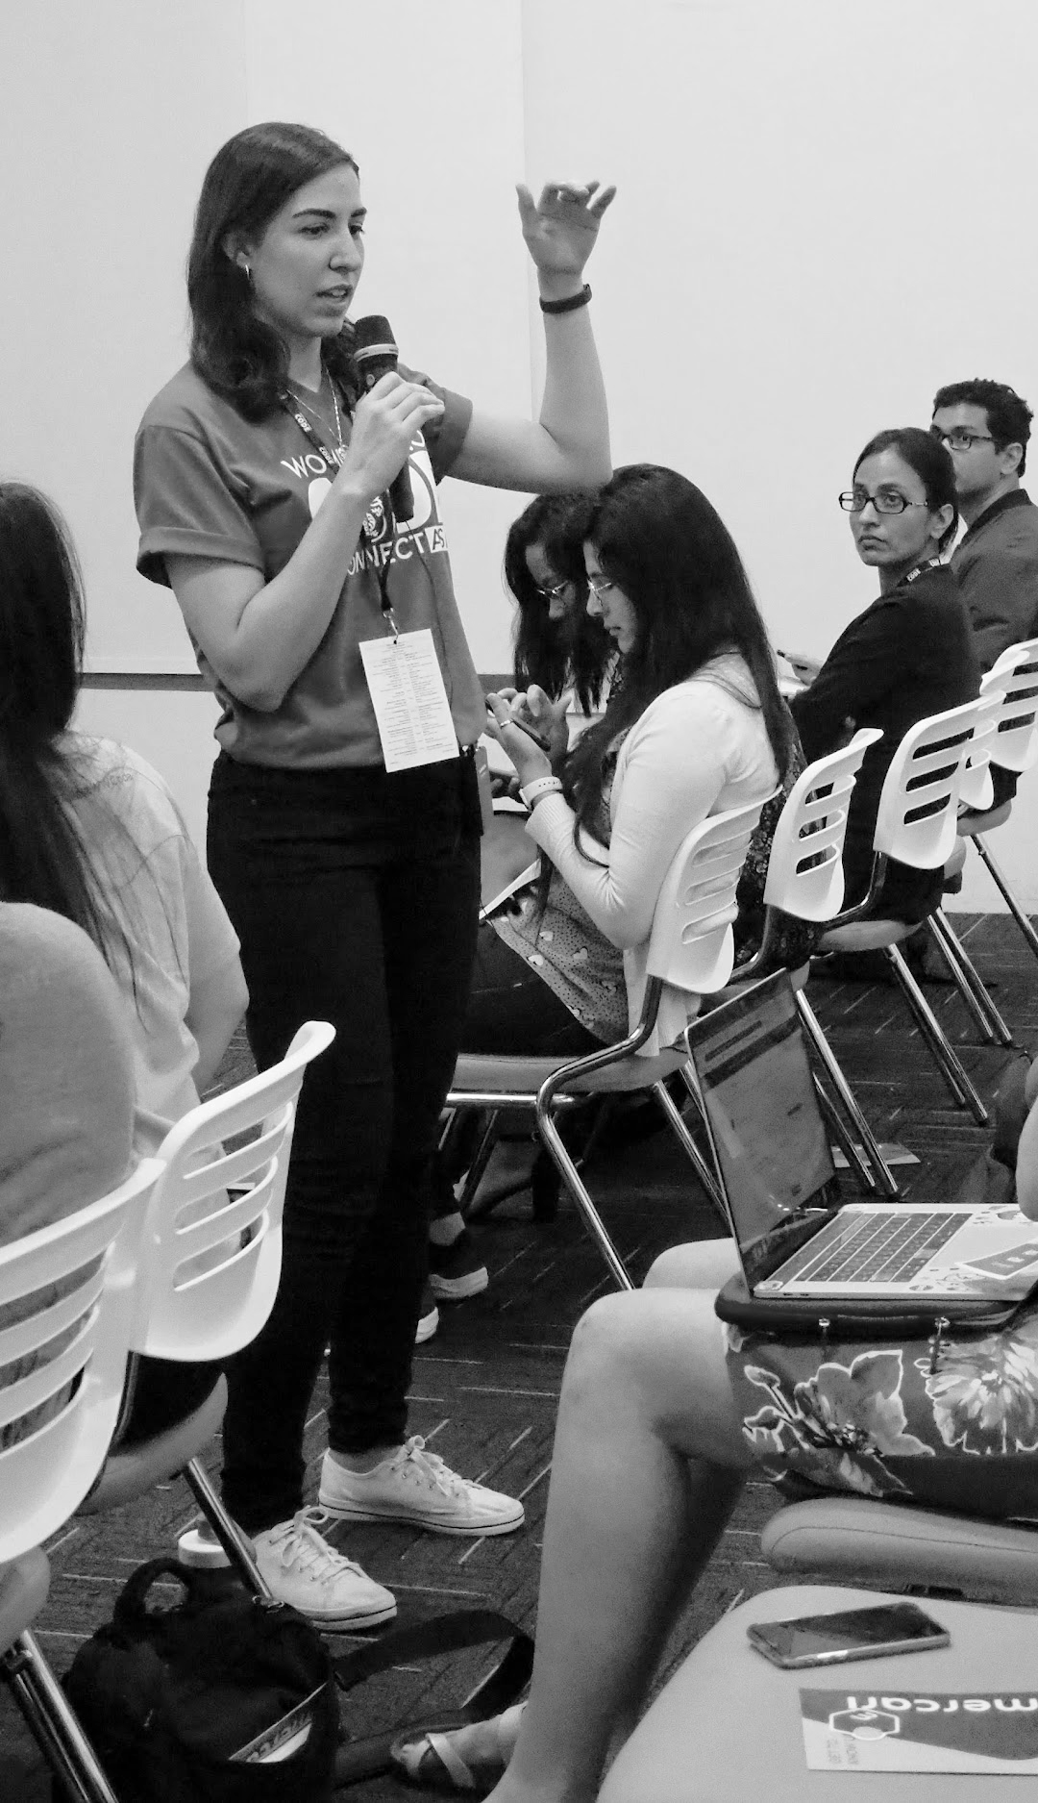
OUR MOVEMENT
As the world changes, we can be a connecting force that creates a sense of belonging while the world is being asked to isolate.
Notes:
Since the world pandemic WWCode have made a new movement statement.

Slide 7
Code of Conduct
WWCode is an inclusive community, dedicated to providing an empowering experience for everyone who participates in or supports our community, regardless of gender, gender identity and expression, sexual orientation, ability, physical appearance, body size, race, ethnicity, age, religion, socioeconomic status, caste, creed, political affiliation, or preferred programming language(s).
Our events are intended to inspire women to excel in technology careers, and anyone who is there for this purpose is welcome. We do not tolerate harassment of members in any form. Our Code of Conduct applies to all WWCode events and online communities.
Read the full version and access our incident report form at womenwhocode.com/codeofconduct
Notes:
Let the participants know that our Code Of Conduct applied to all events and online communities and if they want to read the full version to visit the link.

Slide 8
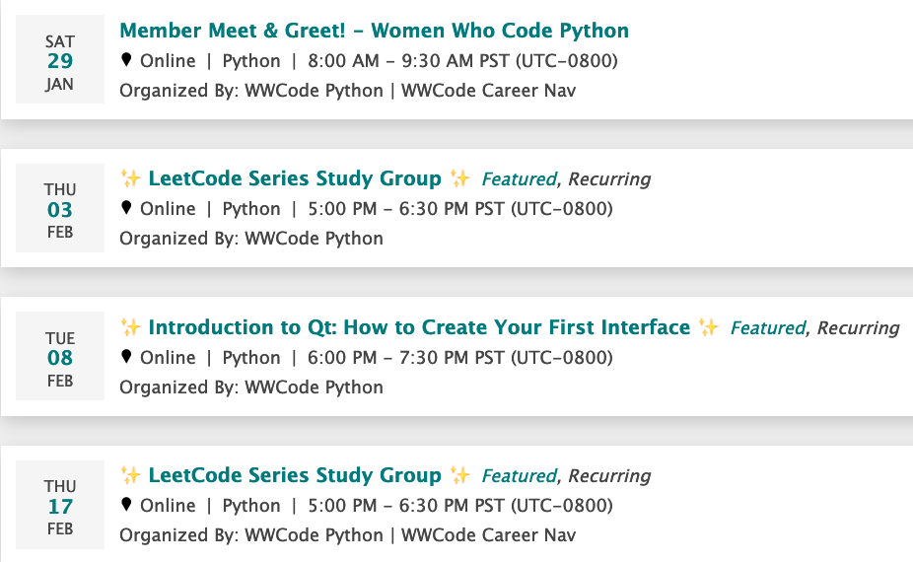
Upcoming Events
Notes:
Add any upcoming events to the slides and send womenwhocode.com/datascience/events to webinar chat box

Slide 9



Follow us
Register for Events and Join our community - womenwhocode.com/python
Email - python@womenwhocode.com
Social Media:⬇
@WWCodePython
Women Who Code Python
@WWCodePython
Notes:
Send links to all social media accounts in the webinar chat

Slide 10
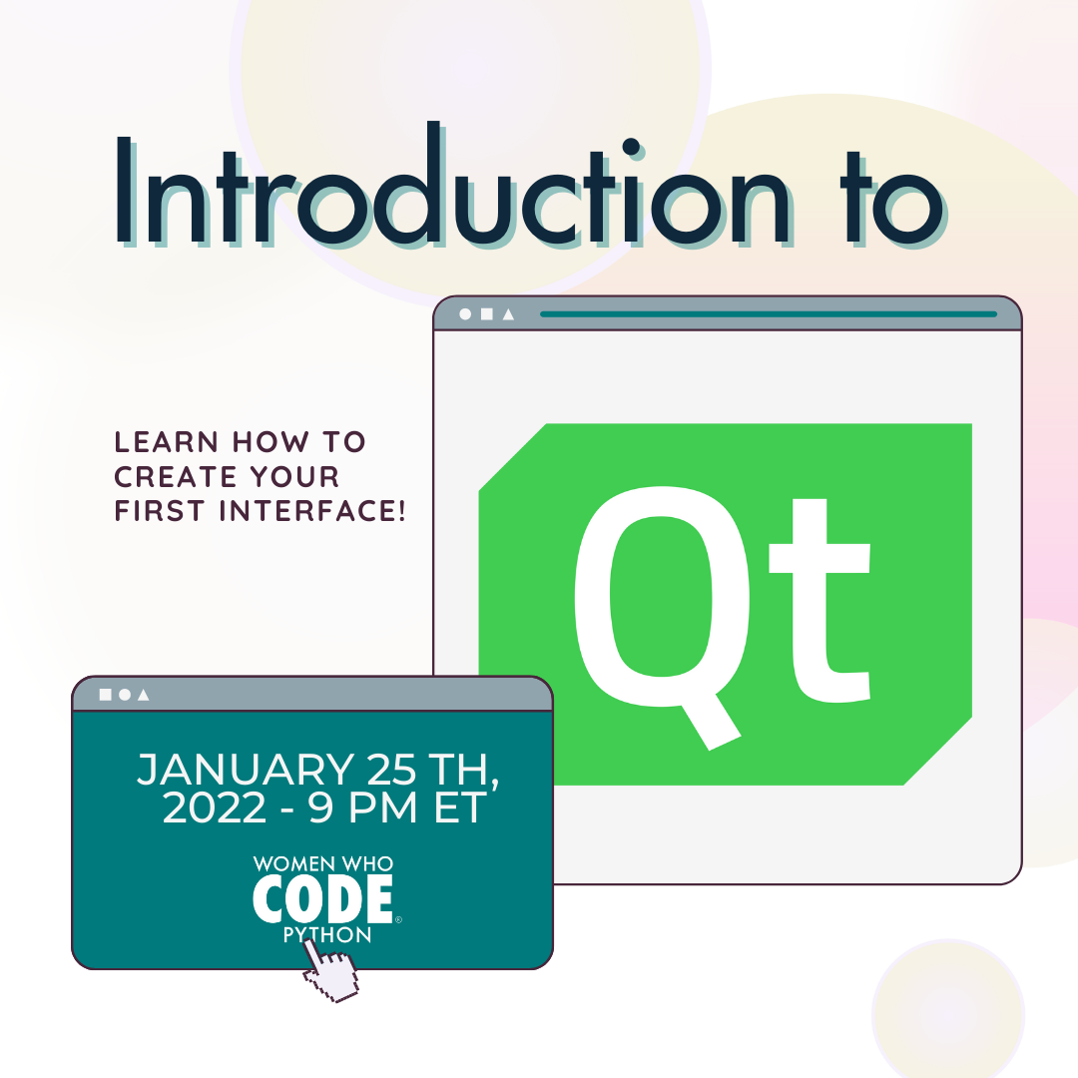
Notes:
Begin Recording at this stage of the intro
Add event graphic to this slide
Introduce event and description
Introduce speaker and read their bio

Slide 11
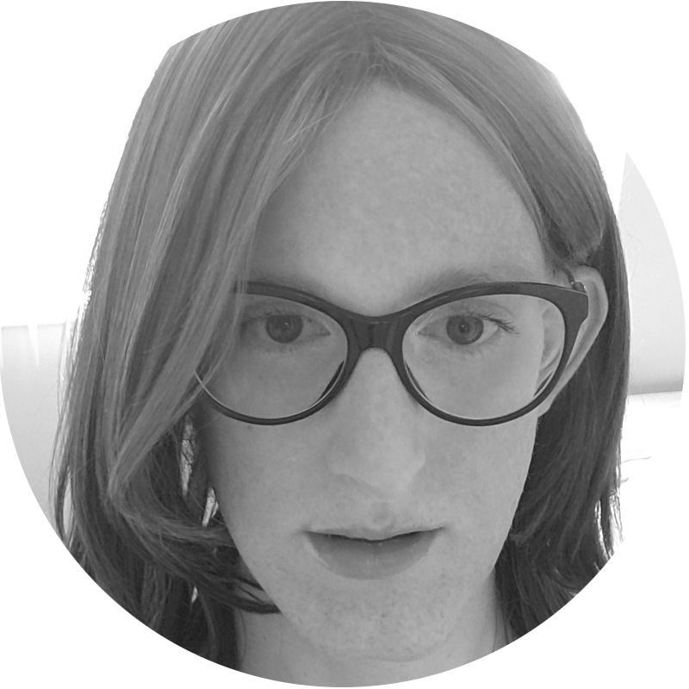
Hi! I’m Jessica
linkedin.com/in/jessicakoubi

Slide 12
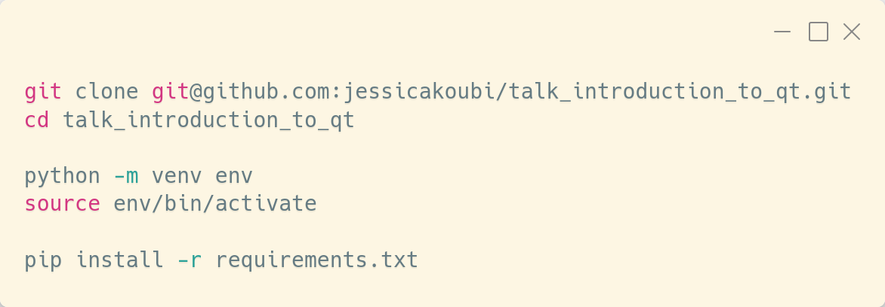
Clone the talk_introduction_to_qt repository.
Create a virtual environment using venv.
Install the required packages with pip.
Creating our virtual environment
Notes:
Q of the day - what’s your favorite snack

Slide 13

Windows/Mac: QPalette.Button and QStyle.QWindowsStyle/QStyle.QMacStyle
Note On Session 1
Notes:
Q of the day - what’s your favorite snack

Slide 14
PySide documentation
https://doc.qt.io/qtforpython/
PyQt Documentation:
https://www.riverbankcomputing.com/software/pyqt/
Navigating QT Documentation
Notes:
Q of the day - what’s your favorite snack

Slide 15
Code available at: https://github.com/jessicakoubi/talk_introduction_to_qt/blob/main/src/session_02
Coding time!
Notes:
Q of the day - what’s your favorite snack

Slide 16
Q&A

Slide 17
Thank you !
Notes:
Q of the day - what’s your favorite snack

Slide 18

Stay Connected
Next session on February 8th 2022 at 21:00 ET
Find more resources related to this talk on github.com/WomenWhoCode/WWCodePython
For additional questions, email me at jessica.koubi@gmail.com

